Slide 1

Chess Engine
Welcome to our presentation on the development of our chess engine, a challenging and rewarding semester project that allowed us to explore the world of game development and object-oriented programming. As passionate chess enthusiasts and aspiring game developers, we recognized early on that creating a chess engine would be the perfect choice for our semester project. Join us as we delve into the design, implementation, and key features of our creation.
Presented by Ali Rafay, Bilal Sarwar,
M. Zayn-Ul-Hassan, Umer Rashid

Slide 2

Problem Statement
Building a Functional Chess Engine
Implementing a User-Friendly Interface
Our primary goal was to build a fully functional chess engine capable of playing against human opponents, offering a challenging and engaging gameplay experience. The engine should be able to analyze positions, make intelligent moves, and adapt to different skill levels.
We aimed to create a user-friendly interface that would be accessible to players of all skill levels, providing intuitive controls, clear visual feedback, and a seamless gaming experience. This included features like move highlighting, visual indicators, and easy navigation.

Slide 3
Objectives
1
Develop a Chess Engine
2
Implement User Interface (UI)
The core objective was to develop a robust chess engine capable of analyzing game positions and generating optimal moves. This involved implementing algorithms for move generation and position evaluation.
We aimed to create a visually appealing and user-friendly interface using JavaFX, allowing players to interact with the engine and make moves. This involved designing an aesthetically pleasing and intuitive interface.
3
Integrate StockFish API
4
Implement a Registration/Login System
The StockFish API was integrated to provide strong AI opponent capabilities. This required careful API integration, handling data flow, and ensuring the engine could communicate effectively with the StockFish engine.
A user registration and login system was implemented, enabling players to create accounts and manage profiles. This involved secure data storage and user authentication mechanisms.

Slide 4
Tools and Technologies
Java
JavaFX
Java was chosen as the primary programming language as told by our instructor, due to its platform independence, extensive libraries, and suitability for game development. It provided a solid foundation for implementing complex logic and game mechanics.
JavaFX was used to develop a graphical user interface, providing a rich set of components and tools for creating visually appealing and interactive elements, allowing for a polished user experience.
StockFish API
OOP Concepts
The StockFish API was integrated to provide powerful AI capabilities. This API allows the engine to communicate with the StockFish chess engine, leveraging its advanced chess analysis and move generation capabilities.
Object-oriented programming principles were applied throughout the development process, leading to a modular, reusable, and well-organized codebase. This helped to improve maintainability, flexibility, and code quality.

Slide 5




System Design
Frontend (JavaFX)
Backend (Java)
Data Storage
Multiplayer Feature
The frontend, built with JavaFX, provides the visual interface for players. It allows users to interact with the game and make moves. This includes elements like the chessboard, piece representation and move highlighting.
The backend, implemented in Java, handles game logic, move generation, position evaluation and user management. This includes algorithms for move validation, board representation and communication with the StockFish engine.
The system utilizes file handling to store user information. This ensures persistent data storage and allows for replaying games and analyzing past performance.
The multiplayer feature allows players to play together on a single computer allowing them to have competitive competitions

Slide 6

Features
1
Multiplayer and Singleplayer
Players can choose to play Multiplayer if they want to challenge their friends, or they can choose to play Singleplayer if you want to level up your skills by playing with an AI of your caliber.
2
Difficulty Levels
Players can choose from various difficulty levels, ranging from easy to hard, allowing them to tailor the challenge to their skill and experience. This provides a range of options for players of all skill levels.
3
User Accounts
Players need to create an account if they want to play the game, they cannot play without an account. They can login to their existing account next time which utilizes file handling.
4
Implementation of Chess Concepts
The engine allows players to review past games, analyze moves, and learn from their mistakes. This helps players improve their game by identifying areas for improvement and understanding successful strategies.

Slide 7

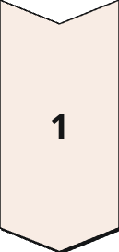
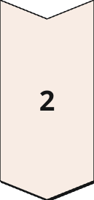
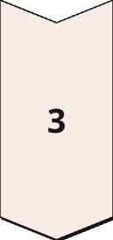
User Interface
Chessboard
The user interface features a visually appealing chessboard with clear piece representation, highlighting active moves and providing feedback if it is an invalid move in the terminal. This allows players to easily track the game and understand the current state of the board.
Multiple Scenes
A Scene Switcher class has been implemented to switch between different screens on the click of buttons. Each screen is easily accessible by clicking the back buttons added at the corner of each screen. Registration/login screens, title screen, player and difficulty chooser screens and a chessboard screen has been added
Move Highlighting
The engine highlights legal moves for the active player, making it easier for users to identify available options and plan their next move. This simplifies gameplay and enhances the user experience.

Slide 8
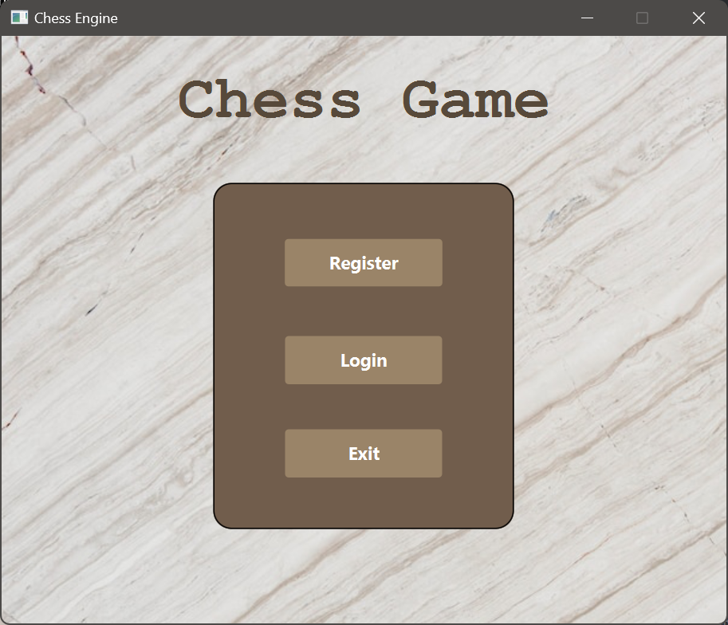
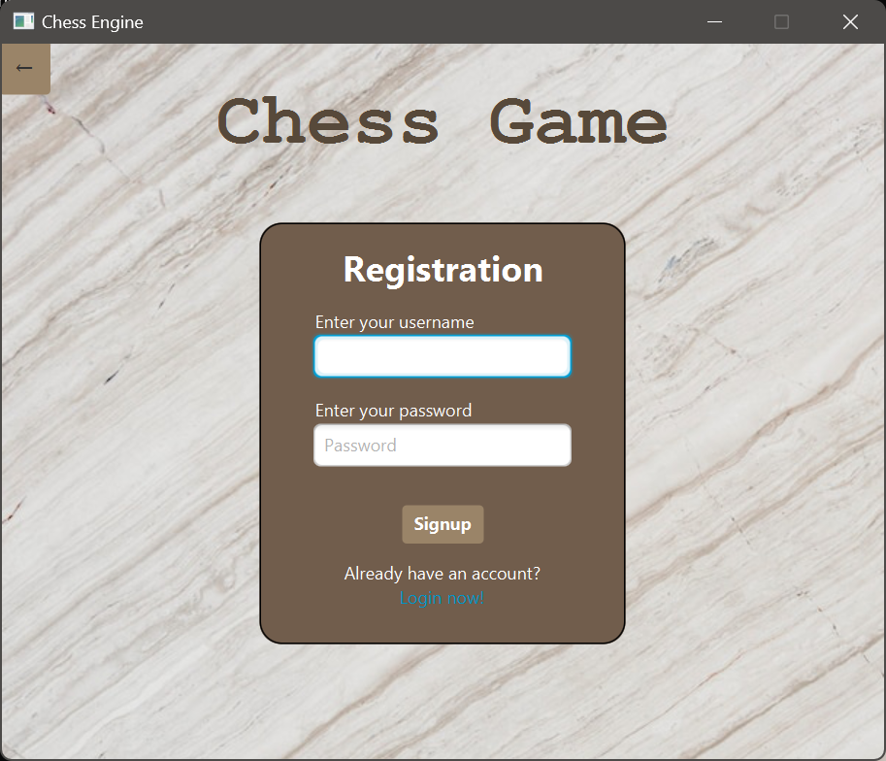
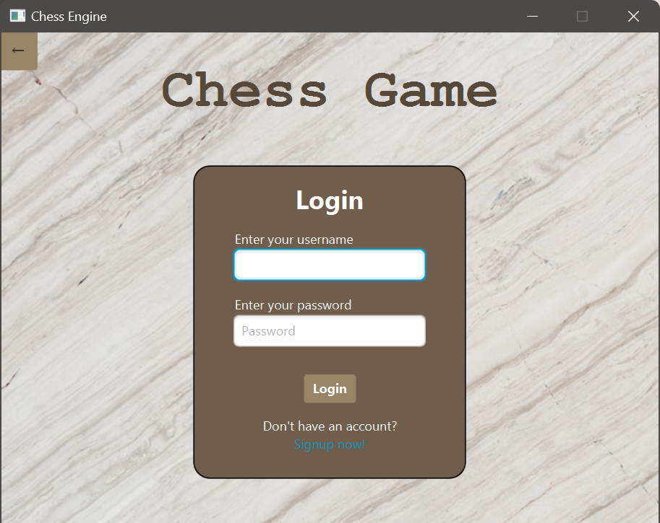
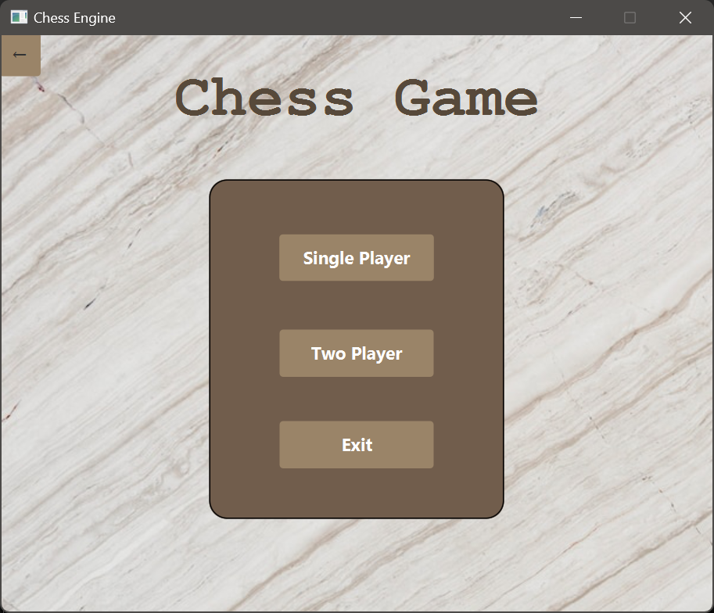



Slide 9
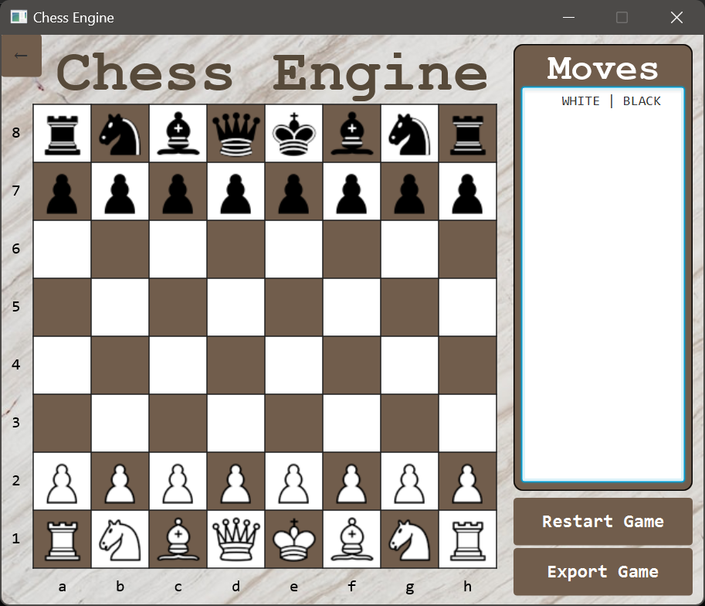
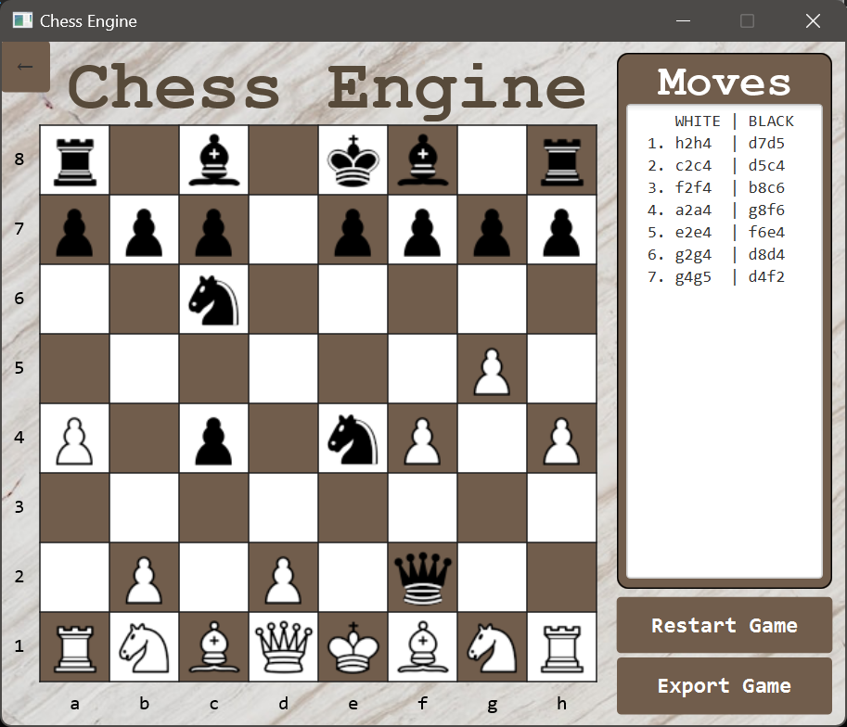
Chess Board

Slide 10
Backend Implementation
Board Representation
1
A two-dimensional array was used to represent the chessboard, efficiently storing and accessing information about the position of pieces and empty squares. This allows for fast and efficient processing of game logic.
2
Move Generation
An algorithm was implemented to generate all possible legal moves for the active player. This involved considering piece types, movement rules, and limitations imposed by the current board state. This ensures all valid moves are considered, providing a comprehensive move list.
Validation of Legal Moves
3
Validation for legal moves was checked by a for loop which ensures that a move does not leave the king in check or place it in check. The logic for this validation involves temporarily simulating the move on the chessboard and checking the king’s safety by calling the inCheck() method for the player’s king.
4
Implementing Complex Chess Concepts
StockFish Integration
It implements complex chess concepts like the En Passant move and Pawn Promotion when it reaches the opponent’s back rank. Kingside and Queenside castling are also implemented. The game also automatically ends in a draw after fifty half moves.
5
The StockFish API was integrated to leverage advanced chess analysis capabilities. This involved handling communication protocols, data exchange, and ensuring the engine could effectively use StockFish's move evaluation and game analysis.

Slide 11

Challenges
1
Integration of StockFIsh
Integrating the StockFish API into our Chess Engine presented a significant challenge, requiring knowledge of many built-in functions, thorough understanding of the API, and a deep understanding of depth-levels. It involved balancing the API output with the backend working of our project.
2
Board Design and Functionality
Creating a user-friendly and intuitive interface for a complex game like chess required careful consideration of design elements and interactive controls. It aimed to simplify gameplay and provide a smooth experience.
3
En Passant, Castling, FEN Strings and Pawn Promotion
Implementing complex Chess logic like En Passant and Castling was a significant challenge as we had to study the concepts in detail and figure out how to implement them. We also had to base our project on FEN Strings and create a separate screen and controller for pawn promotion

Slide 12

Future Enhancements
Multiplayer Mode:
Implement an online multiplayer mode with matchmaking and player rankings to allow users to compete with others globally.
Add support for local multiplayer with split-screen or shared controls.
Support for Variants:
Introduce chess variants like Fischer Random, Bughouse, or Chess960 to broaden the game experience.
Mobile and Cross-Platform Support:
Develop mobile and tablet versions of the game for Android and iOS.
Ensure cross-platform compatibility for a seamless experience across devices.
Tutorial Mode:
Add an interactive tutorial mode for beginners to learn chess rules, strategies, and piece movements.

Slide 13
Learning Outcomes
Our semester project provided valuable learning opportunities in areas like game development, artificial intelligence, object-oriented programming, and user interface design. We gained hands-on experience in implementing complex algorithms, designing user-friendly interfaces, and integrating external APIs. This project fostered teamwork, problem-solving skills, and a deeper understanding of computer science principles.

Slide 14

Conclusion
Our Chess Engine Project was a challenging yet rewarding journey that allowed us to apply the object-oriented programming concepts and problem-solving skills we learned during the semester. Thanks to the guidance and support of our instructor, Sir Zaheer Ahmed Gondal, and through careful planning, collaboration, and dedication, we successfully built a functional chess game with a user-friendly interface and API integration.

